Slide 1
Analog Clock
Project by
Name : Nahidul Islam Shakin
ID : 18CSE246
Project Supervisor
Md. Martuza Ahamad
Assistant Professor

Slide 2
Introduction
Project Title: Analog Clock C++
Create a visually appealing analog clock using C++ and GUI.
Blend classic aesthetics with modern technology.
Showcase the beauty of both programming and design.
Explore the charm of analog timekeeping in a digital world

Slide 3
Overview
Objective:
Design and implement an analog clock.
Utilize C++ programming language.
Incorporate a Graphical User Interface (GUI).
Core Focus:
Create an aesthetically pleasing analog clock.
Offer a unique, interactive timekeeping experience.
Combine the elegance of analog timepieces with modern technology.

Slide 4
Overview
Key features
Real-time time display.
Smooth, visually appealing clock hands movement.
Seamless integration of programming and design.

Slide 5
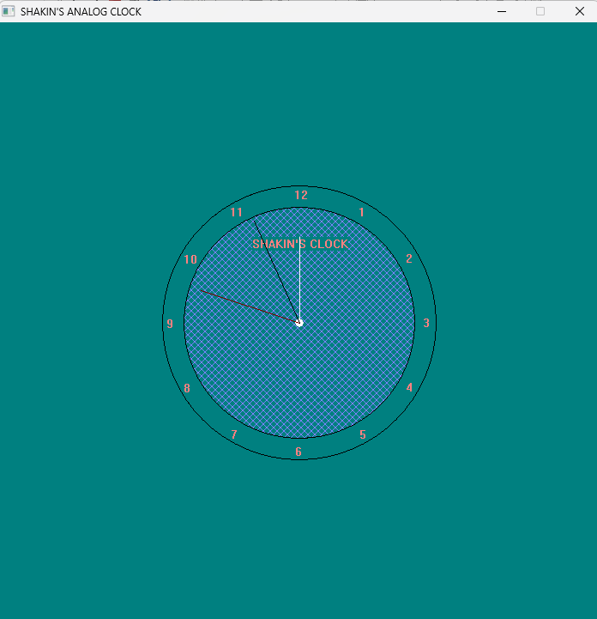
Clock

Slide 6
Code Snippets
Hours numbering:
outtextxy(350+150*sin(1*PI/6)-5 , 350-150*cos(1*PI/6)-7 , "1");
Hours hand:
line(350,350,350+70*sin(ltm->tm_hour * PI/6),350-70*cos(ltm->tm_hour * PI/6));
Minutes hand:
line(350,350,350+100*sin(ltm->tm_min * PI/30),350-100*cos(ltm->tm_min * PI/30));
Second’s hand:
line(350,350,350+130*sin(ltm->tm_sec * PI/30),350-130*cos(ltm->tm_sec * PI/30));
“ltm” is a pointer variable that point to the localtime of the system

Slide 7
Reference
https://www.javatpoint.com/cpp-gui

Slide 8
Conclusion
In this presentation, we embarked on a journey to bring the timeless charm of analog clocks into the digital world using C++ and a GUI.
We successfully designed and implemented an analog clock that not only tells time but also captivates the eye with its aesthetic appeal.
Our Analog Clock C++ GUI project reminds us that in a world driven by digital precision, there’s still room for the elegance and simplicity of analog timekeeping.

Slide 9
Thank You All

